Slide 1


BERT
By, Rahul Kumar

Slide 2
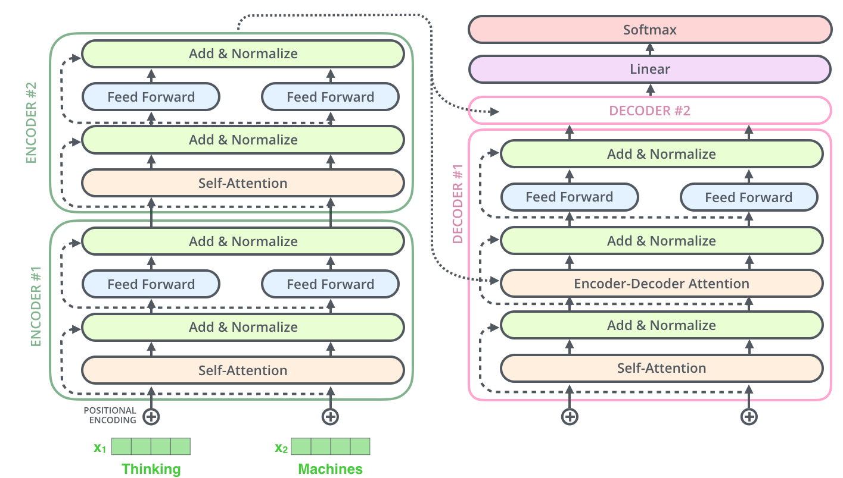
Transformer Architecture

Slide 3
In numerous NLP tasks, language model pre-training has been used to improve the overall performance of the model:
ELMo
OpenAI GPT
ULMFit
There are two methods for utilizing pre-trained language representations for downstream task:
Feature Based: Utilizes task-specific architectures with the pre-trained representations added as extra features (e.g., ELMo (Peters et al., 2018a)).
Fine-tuning: employs task-specific architectures with the pre-trained representations added as extra features.

Slide 4
Limitations of current techniques for NLP
Standard language models are unidirectional:
OpenAI GPT
(utilizes a left-to-right architecture)
ELMo
(concatenates forward and backward
language models)

Slide 5
BERT (Bidirectional Encoder Representation from Transformers)
Model Architecture: Multi-layer Bidirectional Transformer Encoder
Objective: Masked Language Model (MLM) and Next Sentence Prediction (NSP)
Data: BookCorpus (800M words) and Wikipedia (2500M Words)

Slide 6
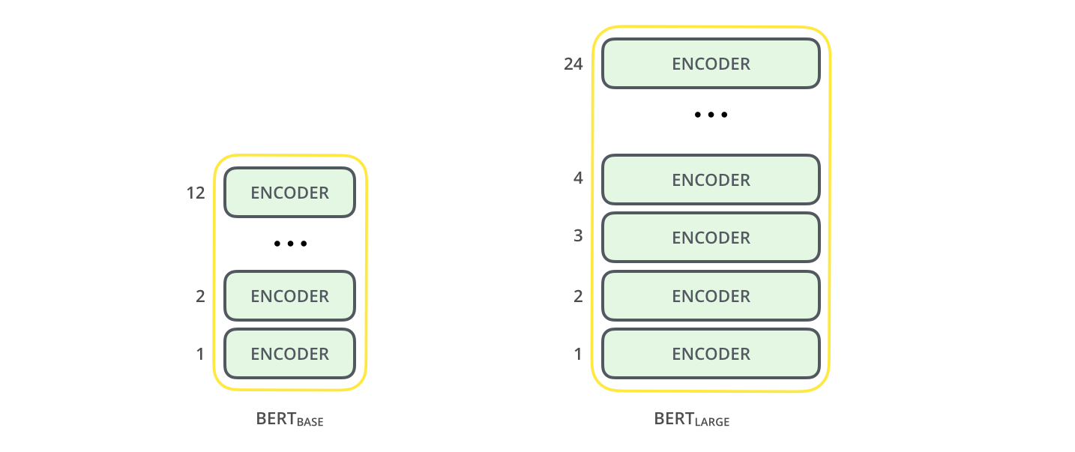
Layers | 12 | 24
Hidden Size | 768 | 1024
Self-attention Heads | 12 | 16
Total Parameters | 110M | 340M

Slide 7
Transformer Encoder (Key concepts)
Positional Encoding
Self- attention
Position-wise Feed Forward Network
Transformer Encoders
Muti-head Self-attention
Layer Normalization
Residual connections

Slide 8
Pre-training BERT
Pre-training of BERT utilizes two unsupervised tasks:
Masked Language Model (MLM)
Next Sentence Prediction (NSP)

Slide 9

Masked Language Model (MLM)
Standard conditional language models can only be trained left-to-right or right-to-left.
BERT handled this issue by using a ‘Masked Language Model’ which is often referred to as a ‘Cloze’ task in literature (Taylor, 1953).
BERT do this by masking 15% of all WordPiece tokens in each sequence at random. Only the masked words get to be predicted rather than reconstructing the entire input.

Slide 10

Problem: [MASK] tokens would only appear in the pre-training and not during fine-tuning.
To mitigate this problem, after the training data generator chooses 15% of tokens randomly for prediction, BERT either:
Replace the token to [MASK] (80% of the time)
Replace the token to a random other token (10% of the time)
Leave the token unchanged (10% of the time)
Finally, the original token is then predicted with cross entropy loss.
creating
a mismatch between pre-training and fine-tuning

Slide 11
Next Sentence Prediction (NSP)
Motivation:
Many downstream tasks such as ‘Question Answering (QA)’ and ‘Natural Language Inference (NLI)’ are based on understanding the relationship between two next sentences
BERT train for a binarized Next Sentence Prediction task that can be trivially generated from any monolingual corpus.
Not directly captured by Language Modeling

Slide 12
In the pretraining phase, BERT model receives pairs of sentences A and B, and it is trained to predict if the second sentence B is the subsequent of the first sentence A.
When selecting the sentences, A and B for each pretraining example,
50% of the time B is the actual next sentence that follows A (labeled as [IsNext]), and
50% of the time it is a random sentence from the corpus (labeled as [NotNext])

Slide 13
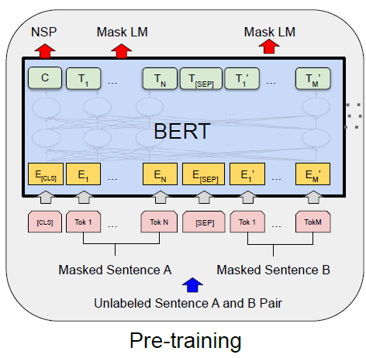

Slide 14
THANK YOU

